Slide 1
NEFRC Quality of Life Indicators: Healthcare
​​
Riya Patel, John Ambers, Nolen Souza, Krupa Patel
Notes:
Everyone?/riya

Slide 2
Scope of the Project
To showcase various health indicators for the following counties in Northeast Florida:
Baker
Clay
Duval
Flagler
Nassau
Putnam
St. Johns
Notes:
Riya

Slide 3
Process
Brainstorm Healthcare Indicators
Discuss Relevant Indicators
Analyze Trends
Gather Data
Create Visualizations
Notes:
Riya
Need to fix the boxes

Slide 4
Quality of Life Healthcare Indicators
Hospitals
Healthcare Facilities with Licensed Beds
Lack of Health Insurance
Check Ups vs. Lack of Health Insurance
Preventive Measures for Seniors
Cancer
High Blood Pressure Rates
Obesity
Diabetes
Notes:
Riya
Here are the indicators we decided to look closer at and map:
FROM CDC: ZCTA Dataset Source (has meanings): https://chronicdata.cdc.gov/500-Cities-Places/PLACES-ZCTA-Data-GIS-Friendly-Format-2021-release/kee5-23sr

Slide 5
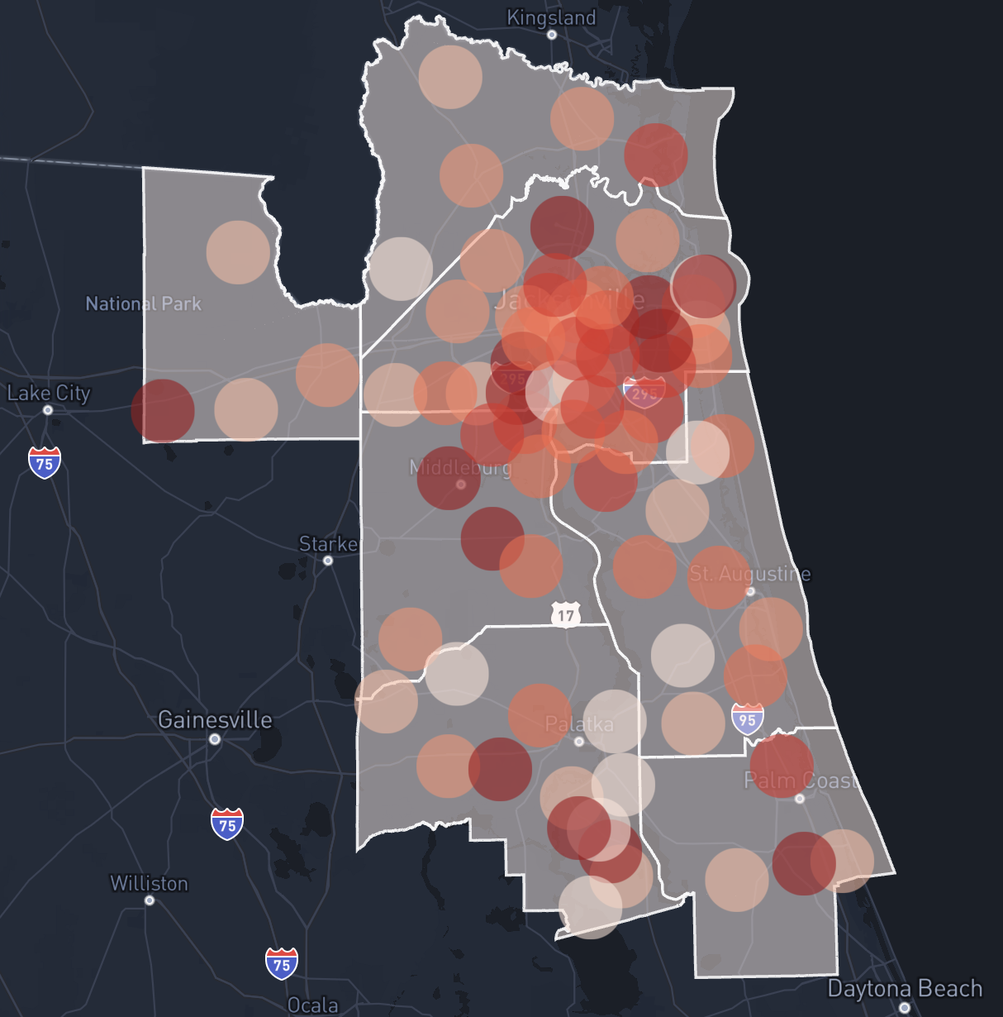
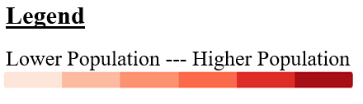
Population Density Map by Zip Code
Nassau
Baker
Duval
Clay
St. Johns
Putnam
Flagler
Notes:
John
Population (Census 2010) currently is shown in incorrect units, should be x1000
Population by ZCTA (Zip Code Tabulation Area) is shown with the red circles, darker is more populated

Slide 6
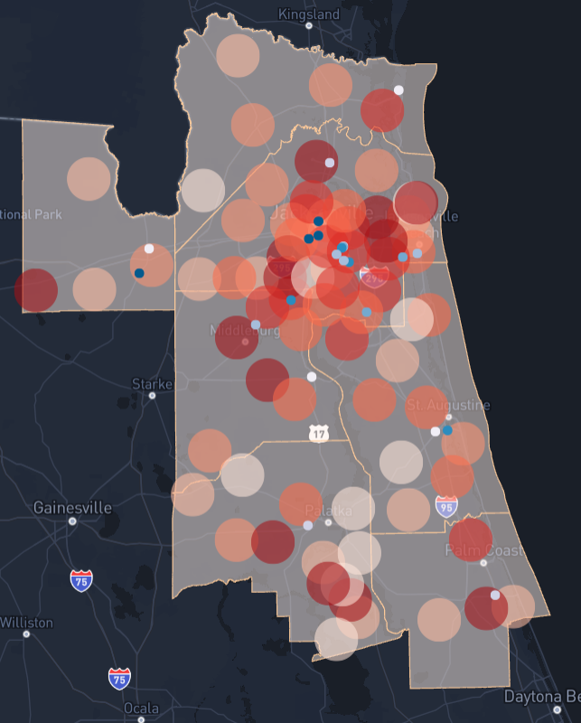
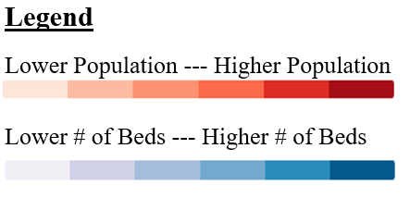
Hospitals
Nassau
Baker
Duval
Area of Interest
Clay
St. Johns
Putnam
Flagler
Notes:
John
Population is shown with the red circles, darker is more populated
Blue dots are hospitals, darker = more beds

Slide 7
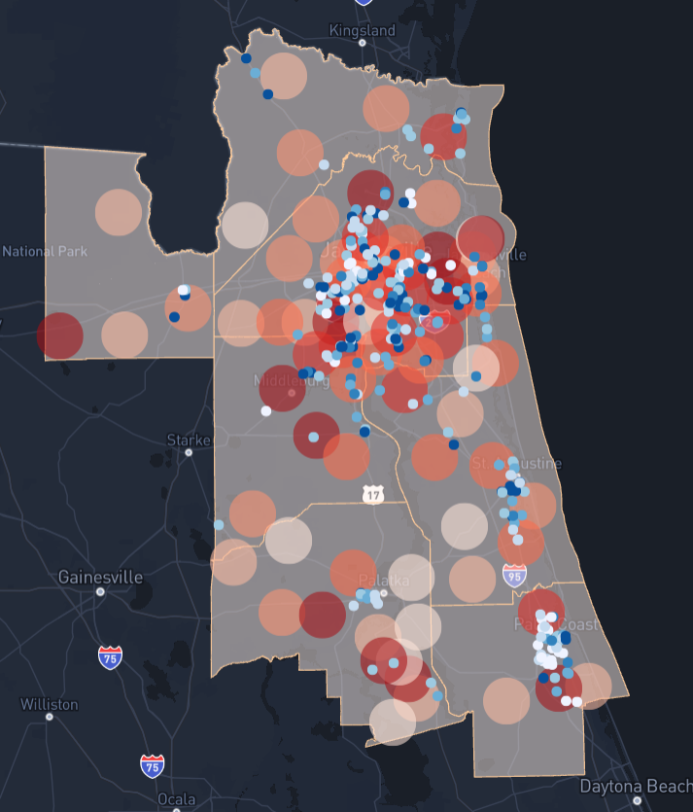
Healthcare Facilities with Licensed Beds
Nassau
Baker
Baker
Duval
St. Johns
Clay
Putnam
Flagler
Notes:
John
Population is shown with the red circles, darker is more populated
Blue dots are facilities with licensed beds, darker = more beds
Facility types include: clinics, labs, rehab centers, nursing homes,

Slide 8
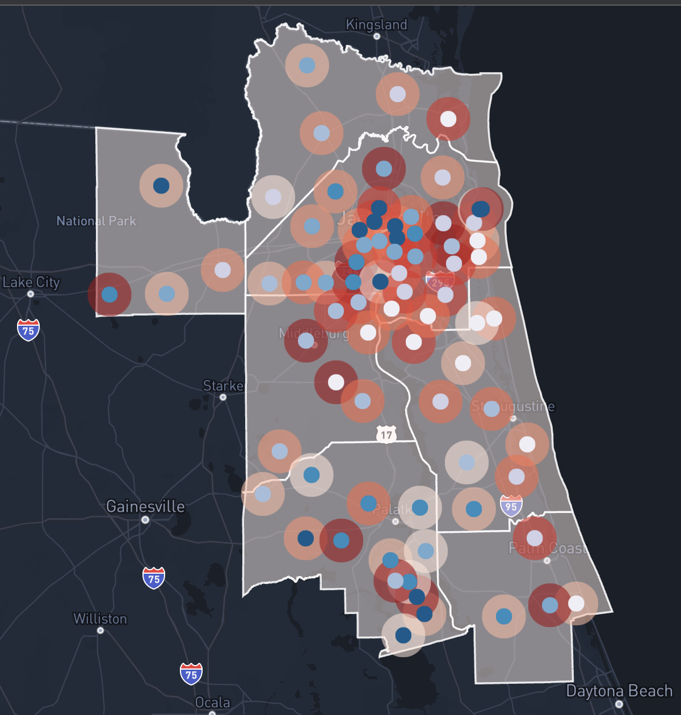
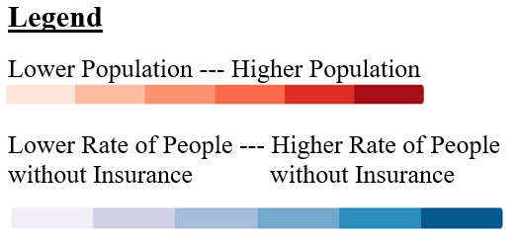
Lack of Health Insurance
Nassau
Baker
Duval
Clay
St. Johns
Putnam
Flagler
Notes:
Nolen
Poor rate = 27
Good rate = 16
Access2_CrudePrev: Model-based estimate for crude prevalence of current lack of health insurance among adults aged 18-64 years, 2019

Slide 9
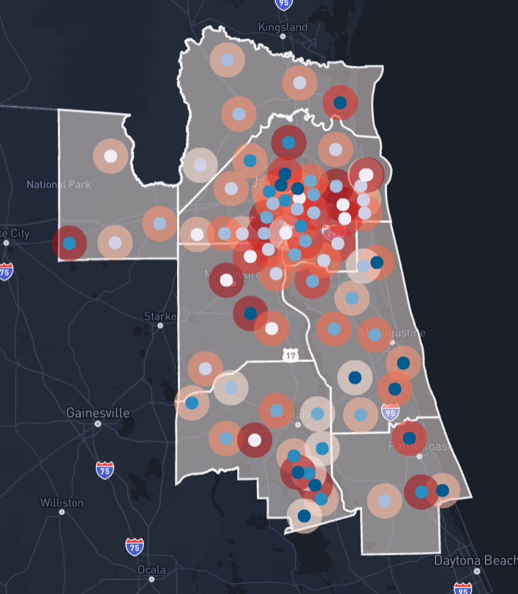
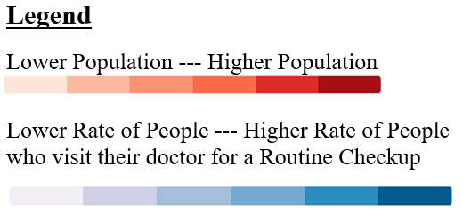
Check Ups vs. Lack of Health Insurance
Nassau
Nassau
Baker
Duval
Baker
Duval
Clay
Clay
St. Johns
St. Johns
Putnam
Putnam
Flagler
Flagler
Notes:
Nolen
CHECKUP_CrudePrev: Model-based estimate for crude prevalence of visits to doctor for routine checkup within the past year among adults (2019)

Slide 10
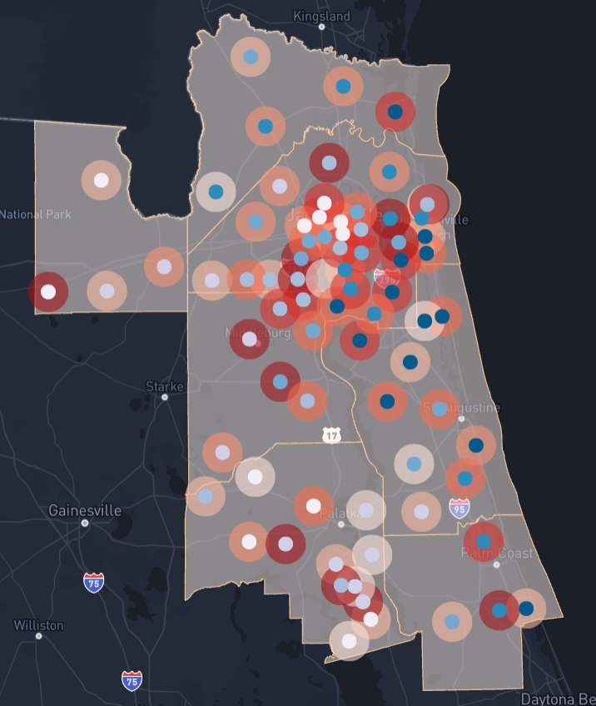
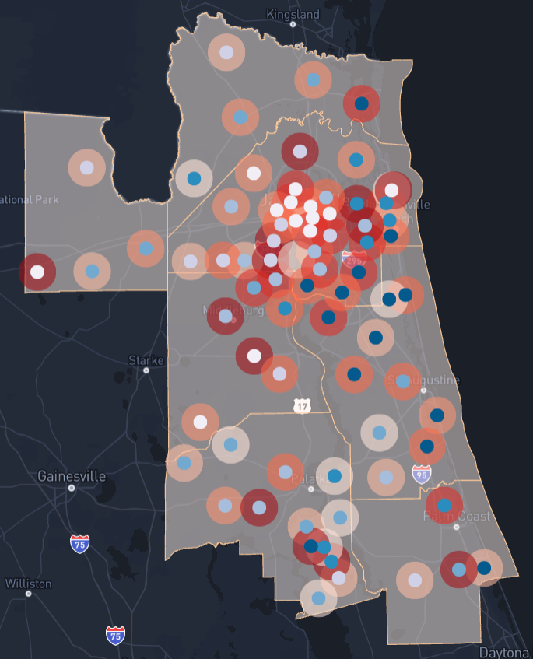
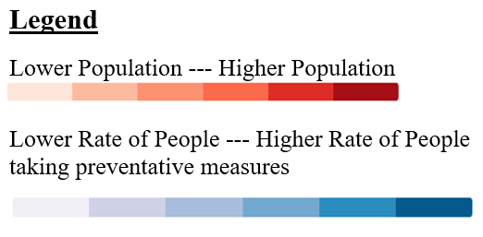
Preventative Measures for Seniors
Men >= 65 years old
Women >= 65 years old
Flu shot past year, PPV shot ever, Colorectal cancer screening, and Mammogram past 2 years, 2018
Nassau
Nassau
Baker
Duval
Baker
Duval
Nassau
Clay
Clay
St. Johns
Bake
Duval
St. Johns
Putnam
Putnam
Clay
Flagler
Flagler
St. Johns
Putnam
Flagler
Notes:
Nolen
COREW_CrudePrev: Model-based estimate for crude prevalence of older adult women aged >=65 years who are up to date on a core set of clinical preventive services: Flu shot past year, PPV shot ever, Colorectal cancer screening, and Mammogram past 2 years, 2018
COREM_CrudePrev: Model-based estimate for crude prevalence of older adult men aged >=65 years who are up to date on a core set of clinical preventive services: Flu shot past year, PPV shot ever, Colorectal cancer screening, 2018

Slide 11
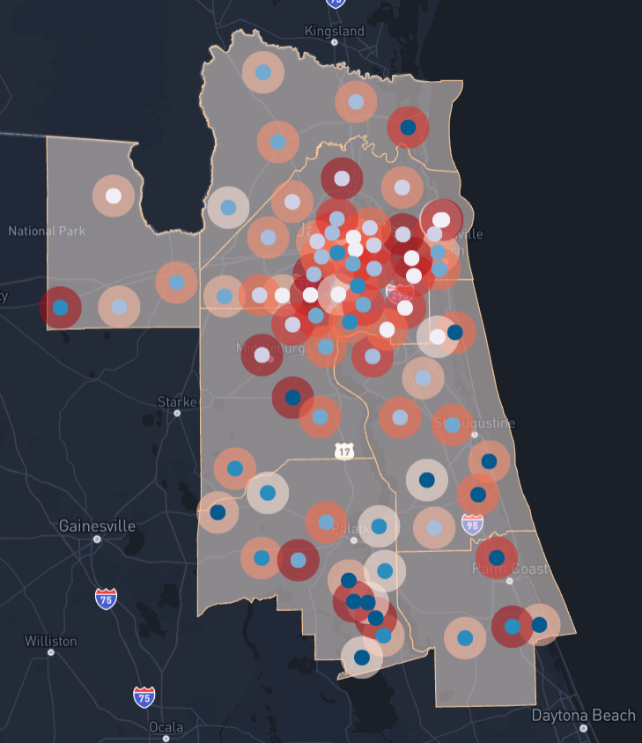
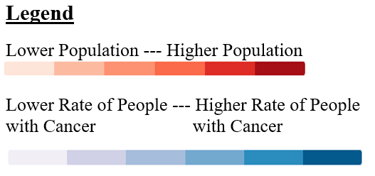
Cancer
Nassau
Baker
Duval
Clay
St. Johns
Putnam
Flagler
Notes:
Nolen
CANCER_CrudePrev: Model-based estimate for crude prevalence of cancer (excluding skin cancer) among adults (2019)

Slide 12
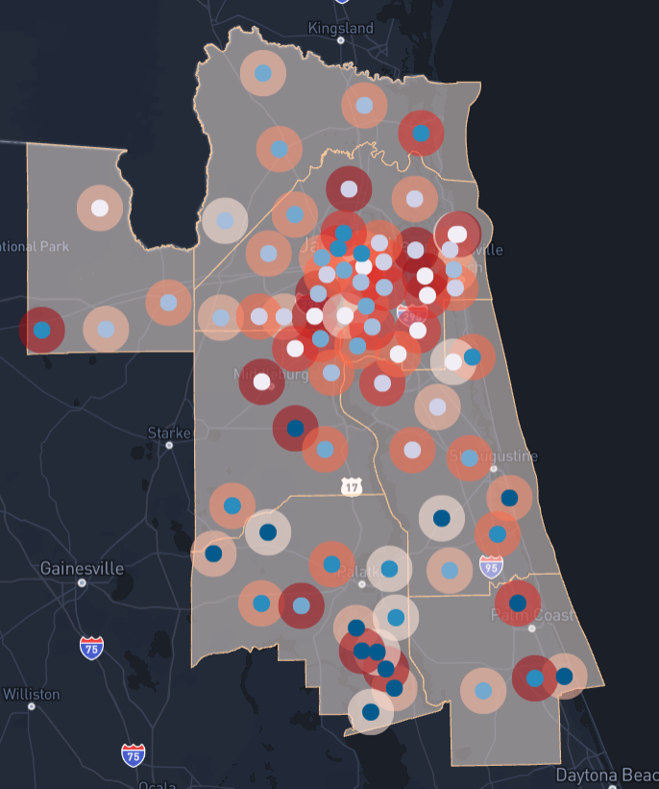
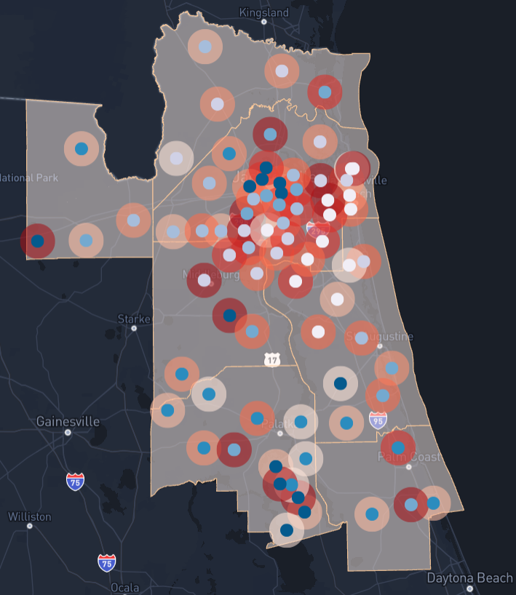
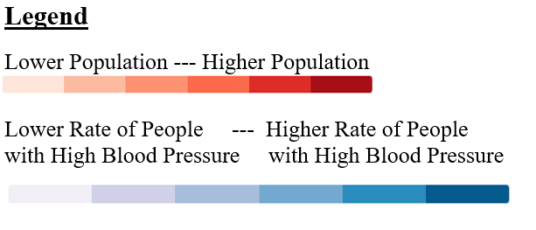
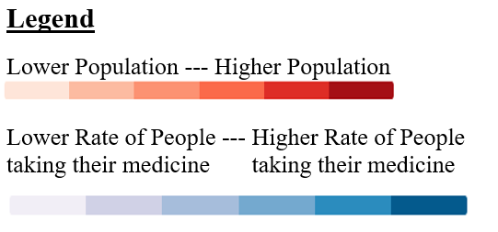
High Blood Pressure
Nassau
Nassau
Baker
Duval
Baker
Duval
Clay
Clay
St. Johns
St. Johns
Putnam
Putnam
Flagler
Flagler
Notes:
Riya
Rate of Adults with High Blood Pressure
Southwest Baker County, has a high rate of people with high blood pressure, but they don’t seem to be taking their medicine high blood pressure
Model-based estimate for crude prevalence of high blood pressure among adults (2019) vs. Crude prevalence of taking medicine for high blood pressure control among adults with high blood pressure (2019)

Slide 13
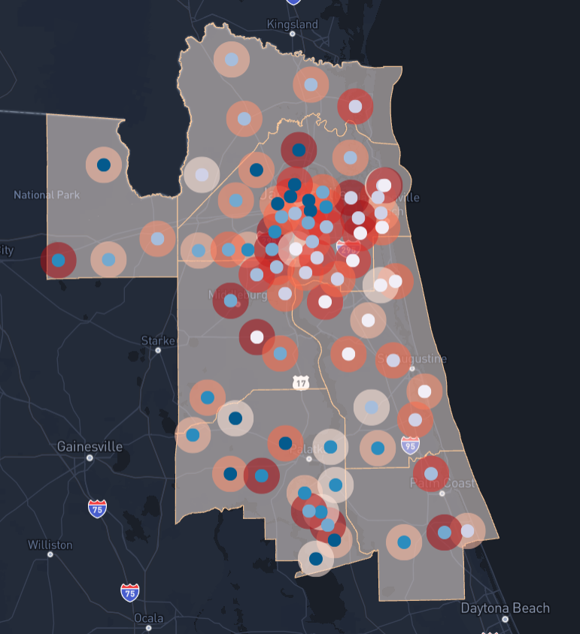
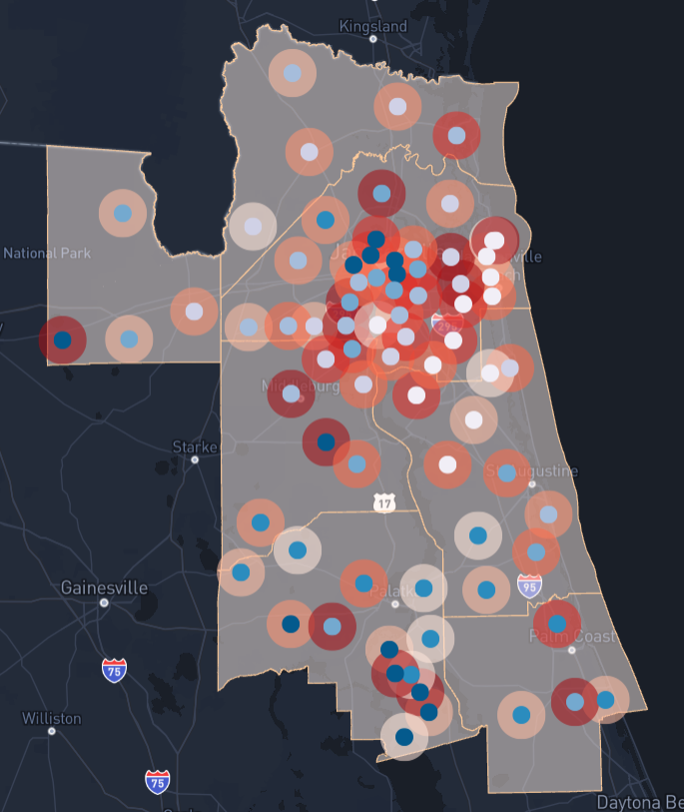
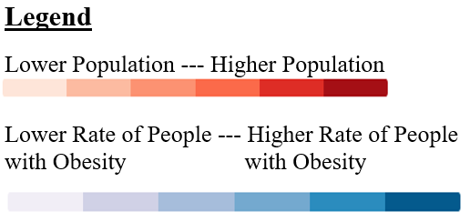

Obesity & Diabetes
Nassau
Nassau
Baker
Duval
Baker
Duval
Clay
Clay
St. Johns
St. Johns
Putnam
Putnam
Flagler
Flagler
Notes:
Riya
OBESITY_CrudePrev: Model-based estimate for crude prevalence of obesity among adults (2019)
DIABETES_CrudePrev: Model-based estimate for crude prevalence of diagnosed diabetes among adults (2019)

Slide 14
Other Indicators
In addition to the indicators we discussed, our Zip Code data set also includes:
Asthma
Cervical Cancer
COPD
Dental Visits
High Cholesterol
Kidney Disease
Stroke
Etc.
Notes:
Riya
If they are interested in any of these other factors, its in our dataset and can be easily mapped
COPD: chronic obstructive pulmonary disease

Slide 15
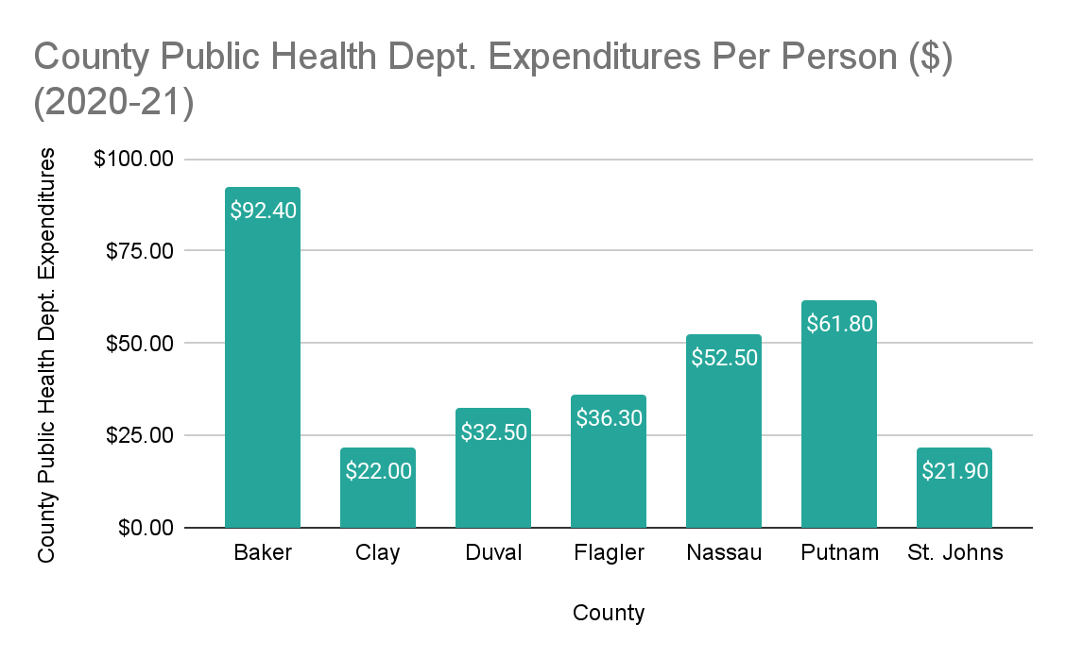
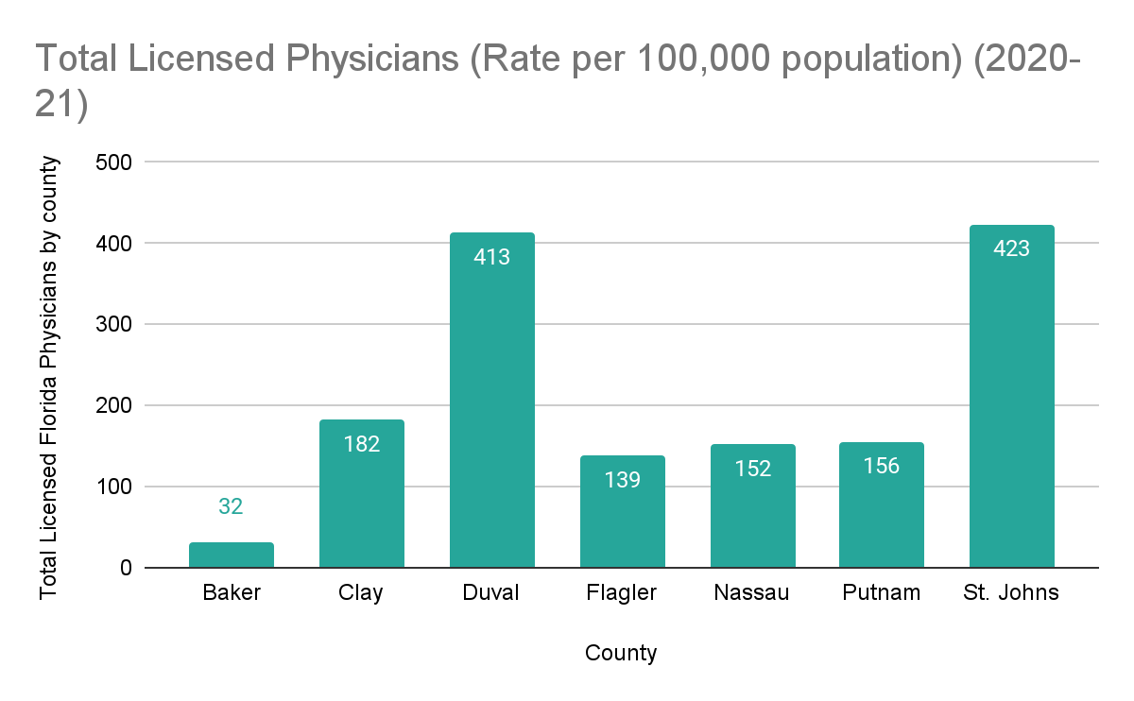
County Level Data
Notes:
John
Data Source: Florida Department of Health, Division of Public Health Statistics and Performance Management

Slide 16
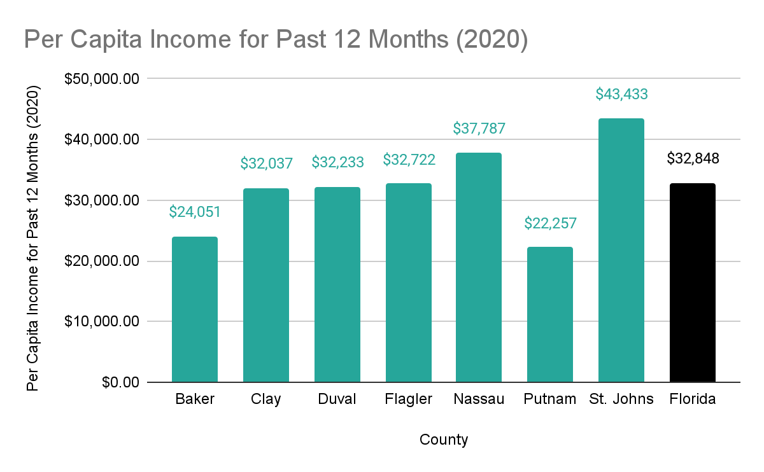
County Level Data
Notes:
John
Source: US Census

Slide 17
Ideas for Next Steps
Allow the Northeast Florida Regional Council to review the map to determine more granular indicators
Focusing on a smaller area of concern
Expanding on additional indicators
Mental health services
Access to recreational activities
Socioeconomic status
Notes:
John

Slide 18
Questions & Answers
Notes:
Everyone

